Slide 1
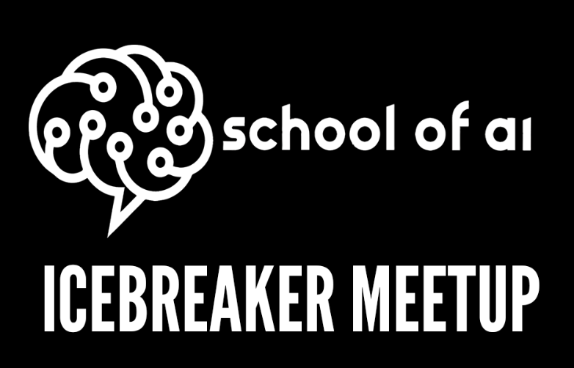
21st Sept 2018

Slide 2
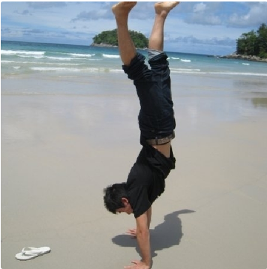

Welcome
Tatsu Ilya
Charles Malafosse
Product Manager and Artificial Intelligence Lead @ multinational corporation in Geneva.
Master’s in bio-medical engineering. //image processing, FPGA
Entrepeneur in fields of Big data and AI.
Former quant & portfolio manager with 12 years experience.
Engineer Statistics & Computer Science.
Certif: CFA, AWS Solution Architect.

Slide 3
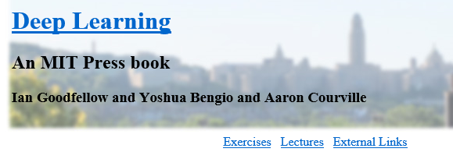
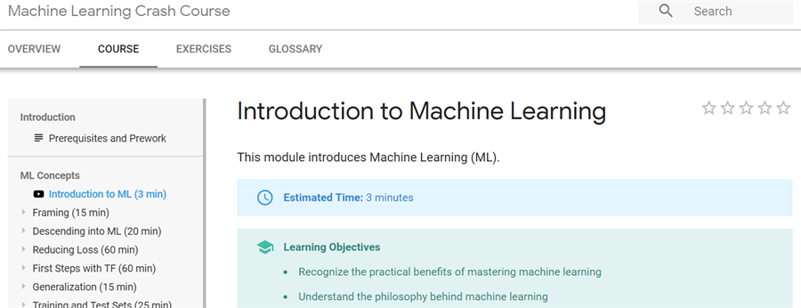
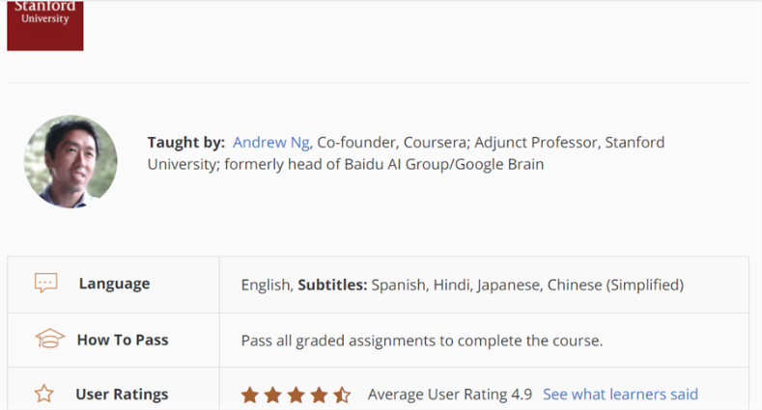
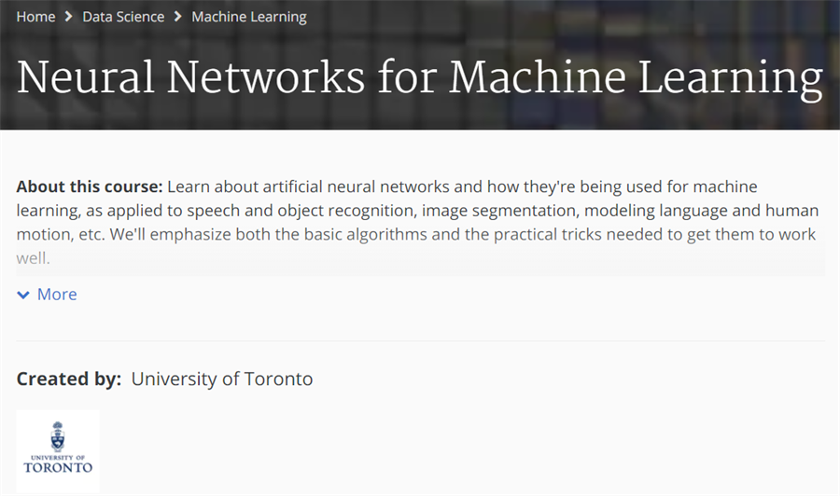
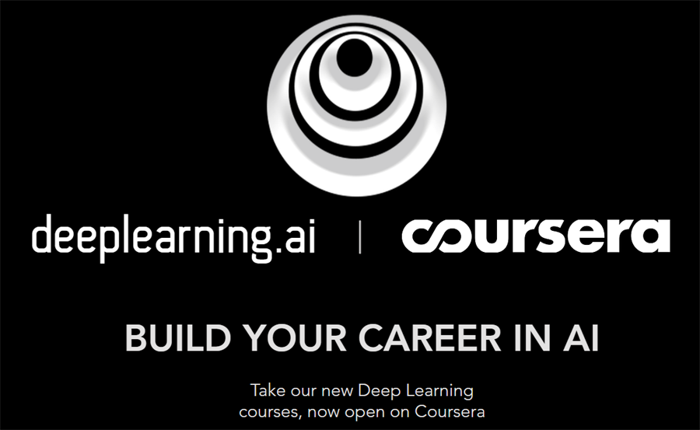
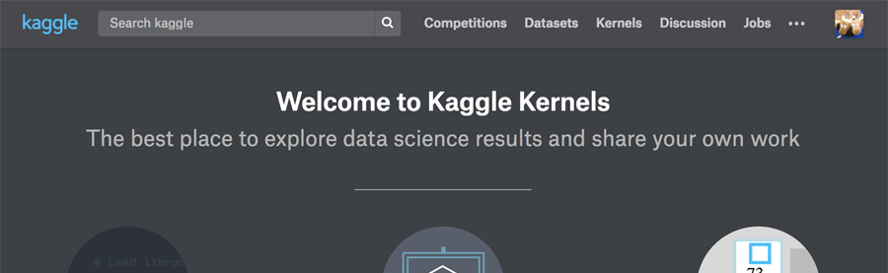
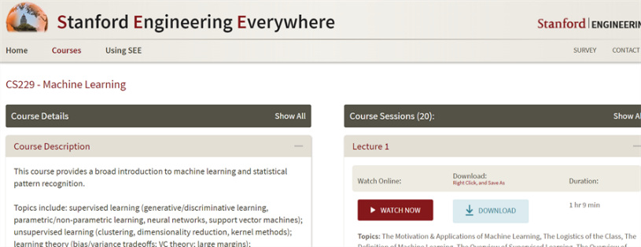
Yes, you can learn ML/AI by yourself

Slide 4
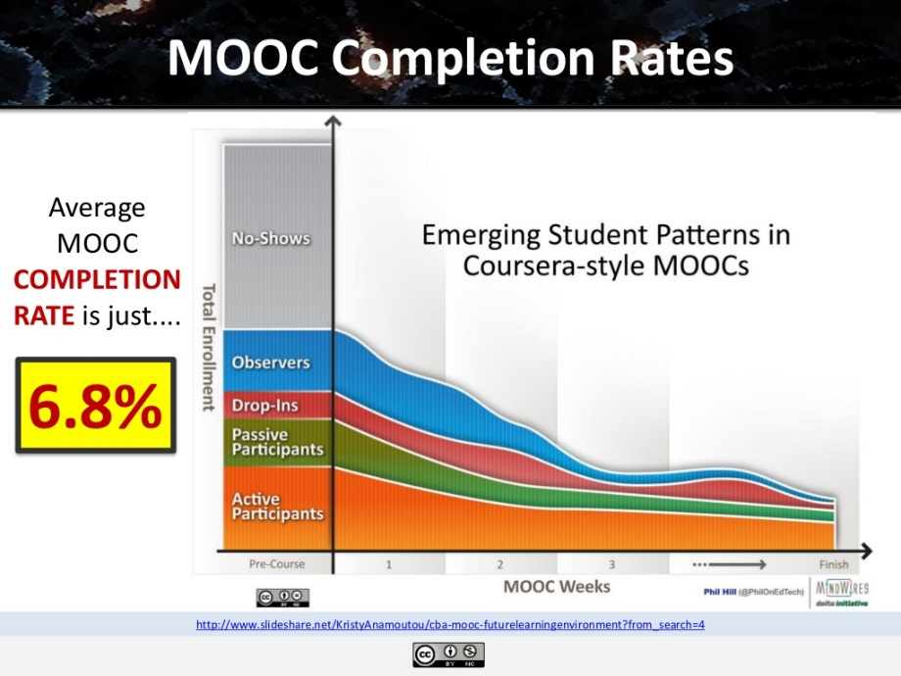
Difficulties in solo-studying AI/ML
Completing MOOCS / Textbooks by yourself
There are tons of world-class AI education materials up there. But it’s just hard to complete by yourself!
Data shows you need positive pressures from others to reach the end.
Confirming your understanding
You can learn more by teaching, and you can really confirm your understanding by teaching. Everyone knows that, but finding an opportunity to teach is difficult when you are learning solo.
Building real-world Application
You can learn theories and methods by yourself. You can also find tutorials using sample datasets yourself. But finding a really interesting and meaningful problems for you to work on next is sometimes difficult.
Sounds familiar?

Slide 5
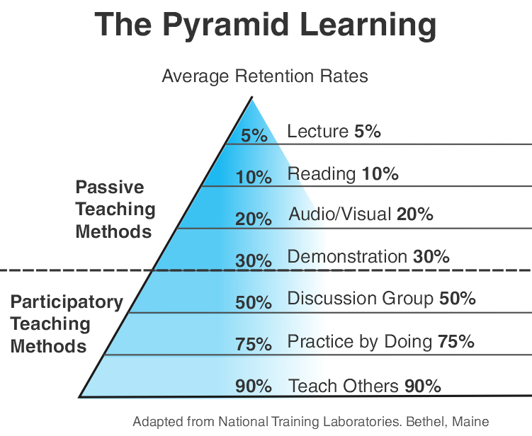
Difficulties in solo-studying AI/ML
Really confirming your understanding
You can learn more by teaching, and by teaching you can really confirm your understanding. We all know that, but finding a teaching opportunity is difficult when you are learning by yourself.
Confirming your understanding
You can learn more by teaching, and you can really confirm your understanding by teaching. Everyone knows that, but finding an opportunity to teach is difficult when you are learning solo.
Building real-world Application
You can learn theories and methods by yourself. You can also find tutorials using sample datasets yourself. But finding a really interesting and meaningful problems for you to work on next is sometimes difficult.

Slide 6
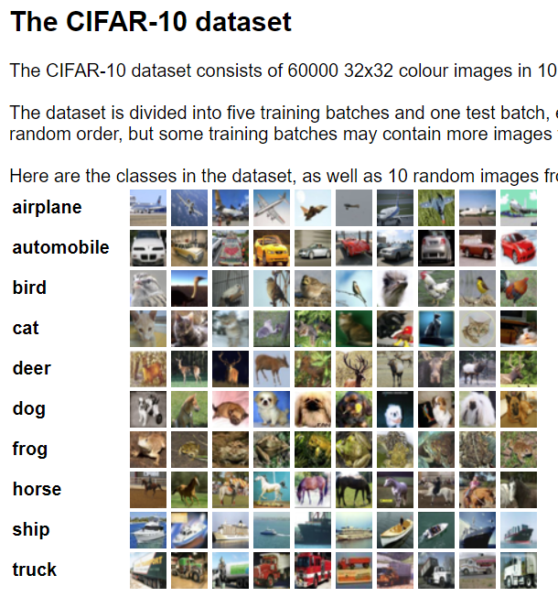
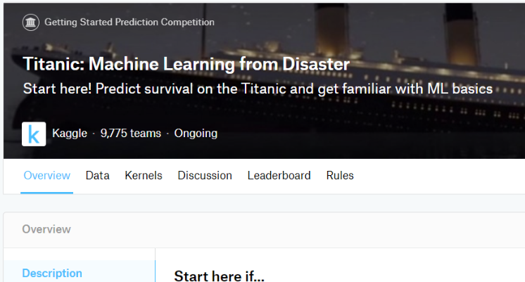
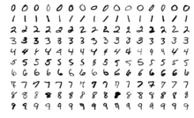
Difficulties in solo-studying AI/ML
Building real-world Application
You can learn theories and methods by yourself. You can also find tutorials using sample datasets yourself. But finding a really interesting and meaningful problems for you to work on next is sometimes difficult.
Confirming your understanding
You can learn more by teaching, and you can really confirm your understanding by teaching. Everyone knows that, but finding an opportunity to teach is difficult when you are learning solo.
Building real-world Application
You can learn theories and methods by yourself. You can also find tutorials using sample datasets yourself. But finding a really interesting and meaningful problems for you to work on next is sometimes difficult.

Slide 7
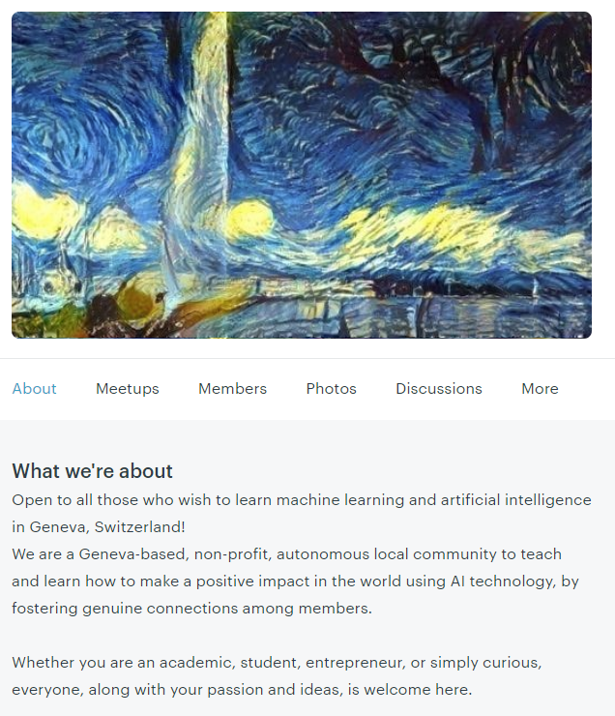
Solution: We are here for you!
130+ members
Genève School of AI
Community to:
Help you complete your MOOCs / Textbooks by positive pressure!
Provide you with teaching opportunities so you can really confirm your understanding and learn more!
Find an interesting and meaningful real-world problems/applications we can work on together!
..and other stuffs you cannot achieve by learning alone!

Slide 8
What’s School of AI?
An international school dedicated to studying, teaching, and creating Artificial Intelligence to help solve the world’s most difficult problems.
Our Core Values
1. Embrace the Weird (We celebrate radically new ways of thinking. The unusual excites us.)
2. Inspire and Educate (When we influence others, we make sure it inspires & educates them in someway).
3. Data Driven Optimism (We’re optimistic people that use data to verify our beliefs.)
4. Rapid Experimentation (We try to fail fast so we can improve the next iteration)
5. Be Frugal (We find clever ways to support ourselves and grow our community, grassroots style)
6. Choose Love, not Fear (We try our best to make all of our decisions based on love for ourselves and others)
7. Draw the Owl (We’re not always given instructions. So we take ownership and figure them out ourselves)

Slide 9
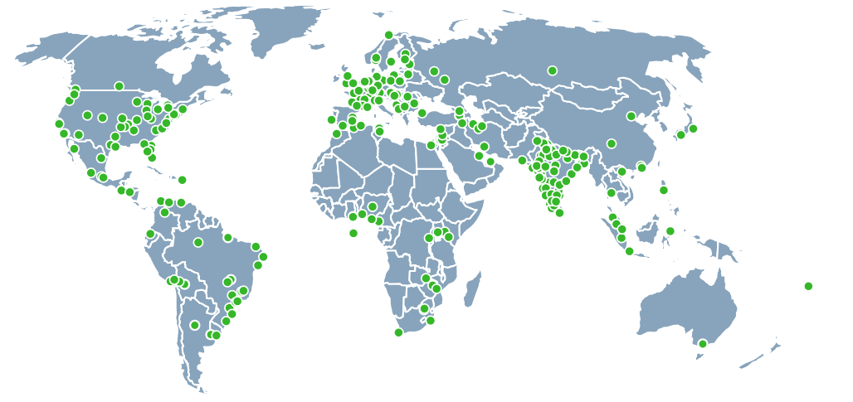
Presence around the world
800 deans for 400 cities

Slide 10
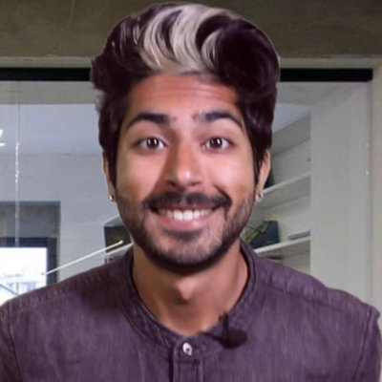
Who’s the Director
Siraj Raval - He lives to serve all Wizards [the shared moniker of the community]. Inspiring, educating, and guiding them along their journey to help them maximize their positive impact in the world using AI technology.

Slide 11
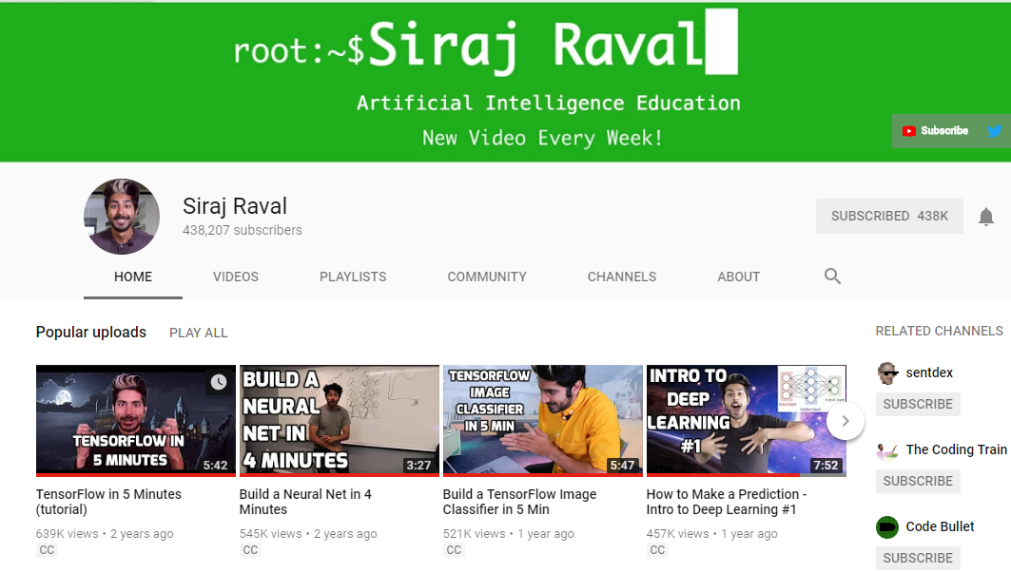
A Youtube channel to follow

Slide 12
Meetup Ideas to discuss
Lightning Talks / Presentations
Classes to teach each other
Study Group
Research Papers
MOOCs
Textbooks
Hands-on Workshop
Involves coding, following presenter’s guides
Hachathon
Creating an AI application
Ideation Session
To find interesting and meaningful problems to work on together
Team Projects
Work on Kaggle(-like) competition together

